Slide 1
BREAST CANCER DETECTION USING PATCH ANTENNA
By
RAVIVARMAN.V RAM KUMAR.S SIVA PRASATH.M
211714106105 211714106102 211714106121
IV year-ECE IV year-ECE IV year-ECE
UNDER THE GUIDANCE OF
Ms. C. MALARVIZHI(M.E)
Assistant professor(SS)
ECE DEPARTMENT

Slide 2
Introduction
Breast tumor is one of the most life-threatening diseases and hence its detection should be fast and accurate.
The medical imaging techniques such MRI, CT ,micro wave are used to detect tumour. However, due to grayscale noise tumour region in image are not properly visible.
Hence we propose a antenna based approach to detect tumour cell less than 10mm.

Slide 3
Objective
The objective of this project to detect the Breast tumor using the antenna as a sensor.
The antenna with minimal microwave radiation place above the breast phantom to detect cancer cell.
Cancer cell if diagnosed when the size is less than 10mm can be treated with tablet.

Slide 4
Literature Review
YEAR | TITLE OF THE PAPER | AUTHOR | ADVANTAGES | DISADVANTAGES
2015 | Microwave hyperthermia for breast cancer treatment using electromagnetic and thermal focusing, tested on realistic breast models and antenna arrays. | Phong thanh nguyen, Amin abbosh, Stuart crozier. | *Only based on amplitude and phase excitation. *Thermal analysis helps to find scaling factor of the antenna. *Only frequency between 3.5Ghz -4.5Ghz is used outside the body. | *Heat produced and radiation produced is higher. *cannot determine the tumour cells in the initial stage.
2014 | Microstrip near-field focusing for microwave non-invasive breast cancer thermotherapy. | Long wang, Dixiang yin, Meng li, Lewei li. | *Microstrip rear view method is used here. *In this paper, the tumour is heated by the radiation effect of antenna and also protects the nipple area. | *Higher frequency is used here,more than 4Ghz. *scaling factor for the antenna cannot be easily determined.

Slide 5
YEAR | TITLE OF THE PAPER | AUTHOR | ADVANTAGES | DISADVANTAGES
2012 | Focused microwave thermotherapy: a patient-specific numerical assessment of a non-invasive breast cancer treatment. | D.A.M.Iero, T.Isernia, L.Crocco, I.Catapano. | *Focused(multi) frequency applicator helps to keep other healthy tissues safe. *Gives better result than single frequency strength method. *Heating potential distribution with multi frequency wave plays vital role. | *Nipple area cannot be safe guard separately in this model. *The tumour cells cannot be detected other than coverage area.
2005 | Time reversal based microwave hyperthermia treatment of breast cancer. | Bin guo, Luzhou Xu, Jian li. | *Better EM energy focusing. *Gives absolute temperature gradients for better hyperthermia treatment. | *EM waves doesnot focus in the tumour region as much as done in microwave therapy.
13/04/2018
Rajalakshmi Institute of Technology
5

Slide 6
Existing Model
The exiting system uses particle swarm optimization (PSO) method to detect optimal point to treat breast cancer.
The antenna operates at 4.2 GHz and heat the cancer cell at 42 degree © to treat the cancer cell.

Slide 7
Proposed Model
We propose a new antenna design with different operating frequencies to detect cancer cells less than 10mm.
The antenna emits minimal radiation compared to conventional systems.
Earlier diagnosis of cancer enables physicians to treat cancer cell with tablets and eliminate the need for surgery and chemotherapy.

Slide 8
Proposed Model-Cont..
Breast phantom
Antenna sensor
signal acquisition
Pre-processing
Spline transformation
Tumor cells determined

Slide 9
Experimental results and discussion
Results:
* Our system shows the presence of cancer cell in the part breast phantom.
* In the fig 1.0 ,the picture shows us the frequency in wave form of the unaffected region in the breast phantom.
* In the fig 1.1,the picture shows us the frequency in wave form of the tumor affected region in the breast phantom.
* The fig 1.2 shows us the spline transformation of the frequency taken from the tumor affected region in the breast phantom.

Slide 10
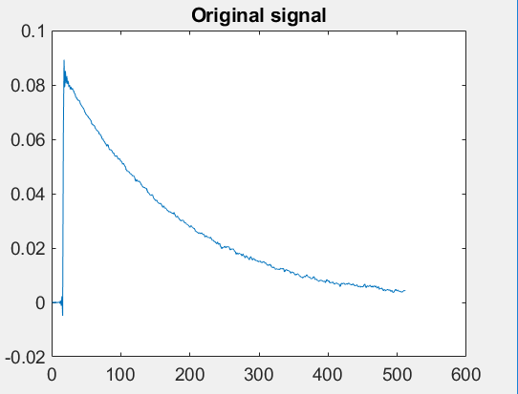
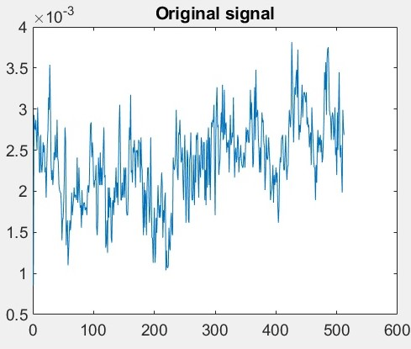
*After the spline transformation the frequency waveform taken from the two region is compared with its variations.this is shown in fig. 1.3.
fig 1.0 fig 1.1

Slide 11
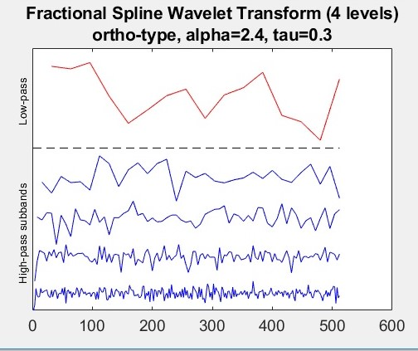
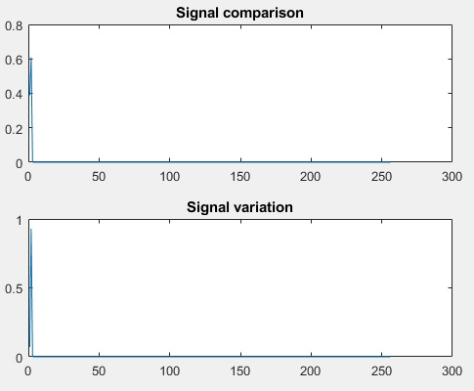
fig 1.2 fig 1.3

Slide 12
EXPERIMENTS CONDUCTED FOR VARIOUS REGION:
REGION | OUTPUT
UNAFFECTED | LOW FREQUENCY
AFFECTED | HIGH FREQUENCY

Slide 13
Conclusion
This project has laid the foundation for experimental validation tests of breast cancer detection. We have made progress with building more realistic breast phantoms. We have also presented a basic first set of tests imaging the phantoms with our system.

Slide 14
Future work
There are many areas in which this work will continue to be explored in the future: incorporation of the low-noise amplifiers and switches into the system ; imaging of phantoms with different sized tumors and with phantoms that have more than one tumor; imaging of phantoms that have glandular tissue ; more thorough investigation of imaging using two antennas that are opposite each other.

Slide 15
References
[1] C. Hahn, and S. Noghanian, "Heterogeneous breast phantom development for microwave imaging using regression models," Int. J. Biomed. Imag., vol. 2012, p. 803607-12, 2012.
[2] I. Ünal, B. Türetken, K. Sürmeli, and C. Canbay, "An experimental microwave imaging system for breast tumor detection on layered phantom model," Gener. Assem. Scient. Sym., Aug. 13-20, p. 1-4, 2011.
[3] J. Garrett, and E. Fear, "A New Breast Phantom With a Durable Skin Layer for Microwave Breast Imaging," IEEE Trans. Antennas Propag., vol. 63, p. 1693-1700, 2015.
[4] N. Joachimowicz, C. Conessa, T. Henriksson, and B. Duchene, "Breast Phantoms for Microwave Imaging," IEEE Antennas Wireless Propag. Lett., vol. 13, p. 1333-1336, 2014.
[5] M.J. Burfeindt, T.J. Colgan, R.O. Mays, J.D. Shea, N. Behdad, B.D. Van Veen, and S.C. Hagness, "MRI-Derived 3-D-Printed Breast Phantom for Microwave Breast Imaging Validation," IEEE Antennas Wireless Propag. Lett., vol. 11, p. 1610-1613, 2012.
[6] Y. Yuan, C. Wyatt, P. MacCarini, P. Stauffer, O. Craciunescu, J. MacFall, M. Dewhirst, and S.K. Das, "A heterogeneous human tissue mimicking phantom for RF heating and MRI thermal monitoring verification," Phys. Med. Biol., vol. 57, p. 2021-2037, 2012

Slide 16
Thank You

